Slide 1
Data exploration given PL&PP correlations
30 May 2016

Slide 2
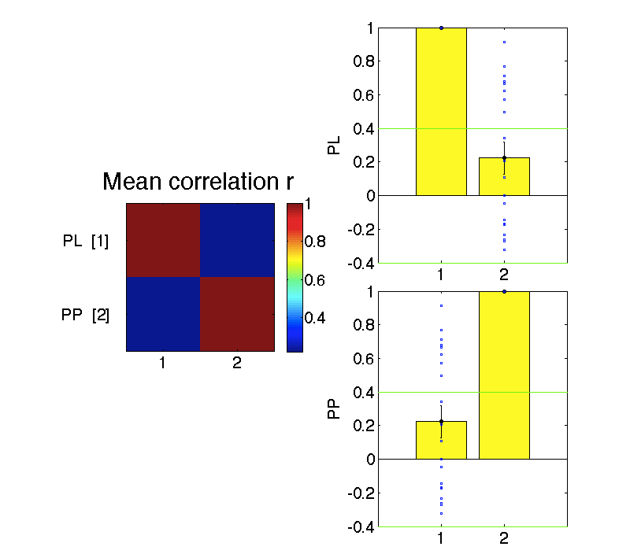
Session 1 – There is a huge range in the extent to which PL and PP are correlated w each other
Correlatedness will hamper our ability to find statistical effects
But we could potentially subsample

Slide 3
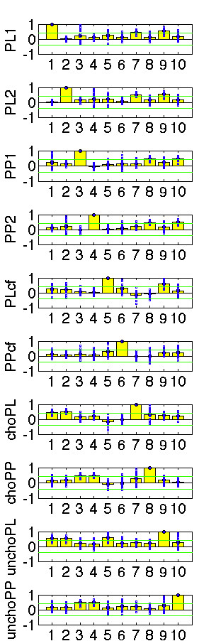
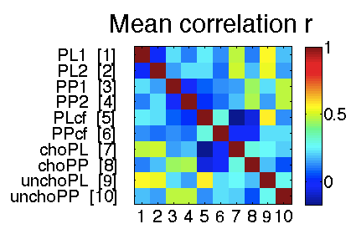
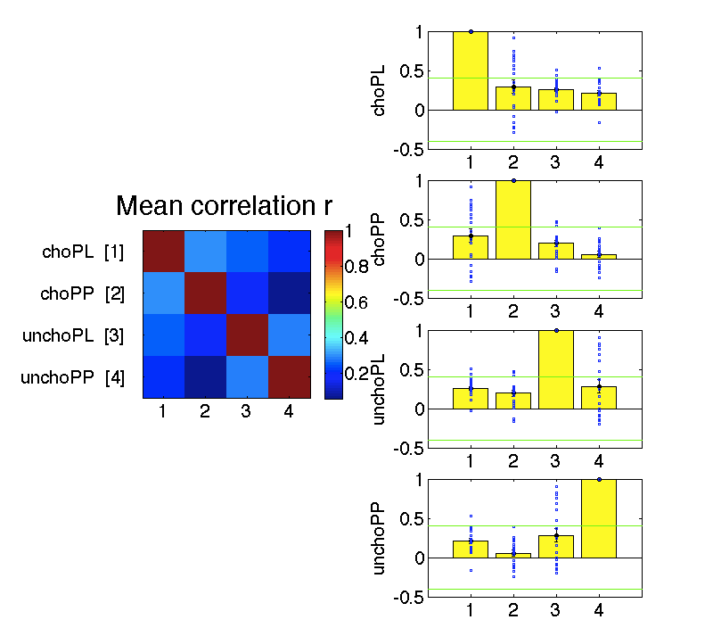
Session 2

Slide 4
Session 2: Chosen and Unchosen values

Slide 5
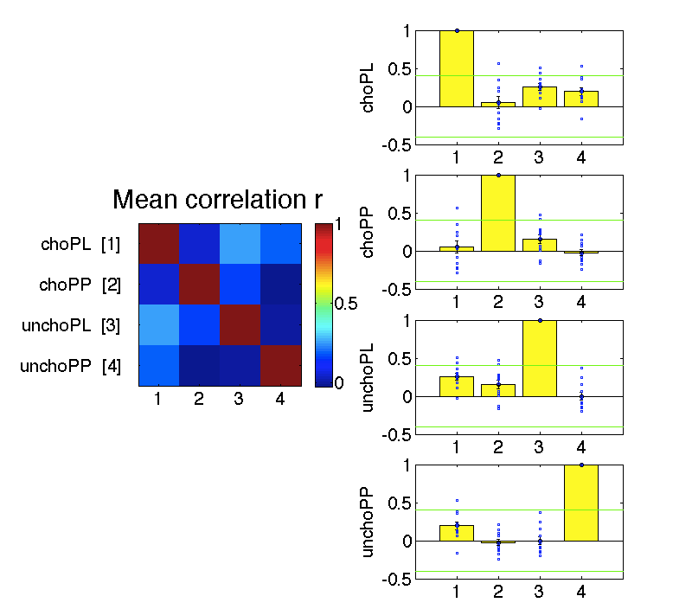
If we restrict to subjects w relatively low general PL vs PP correlation (abs r<.4), Session 2 Cho v Uncho correlations are probably unproblematic
Still this does reduce our power
Also not pictured: collinearity

Slide 6
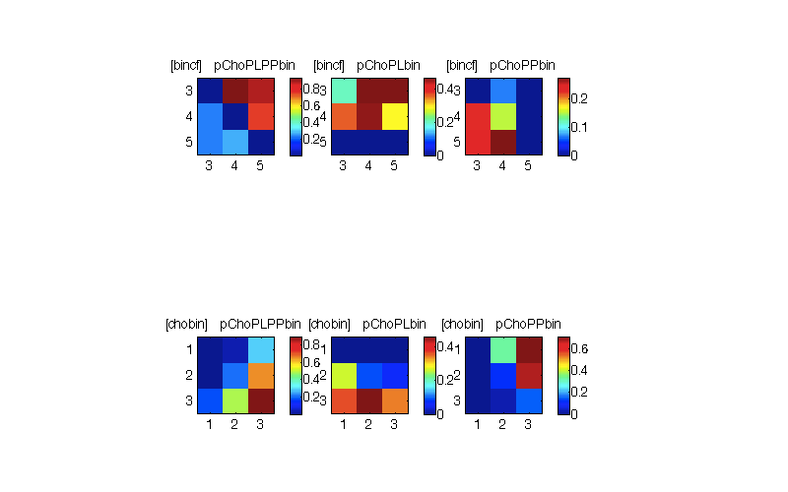
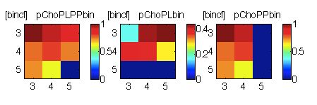
Do simple behavioural heuristics give us the qualitative pattern of behaviour? Limit to n=12, abs PL vs PP r < 0.4 Answer: Yes. Simple heuristics will be almost impossible to disentangle from the dynamic generative model

Slide 7
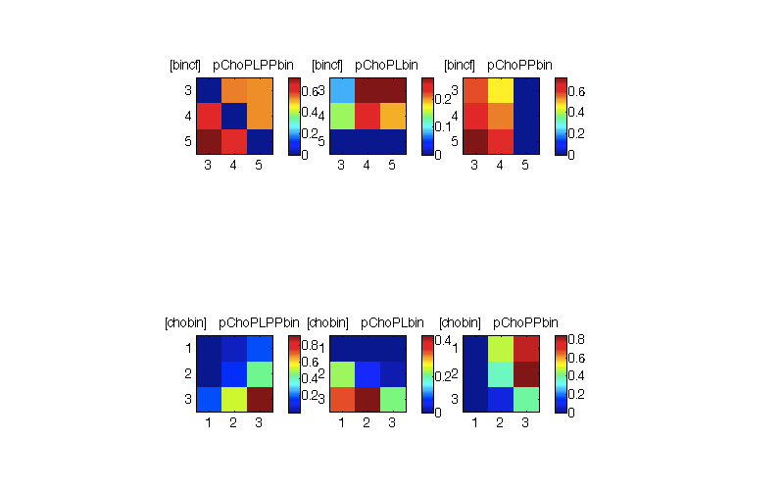
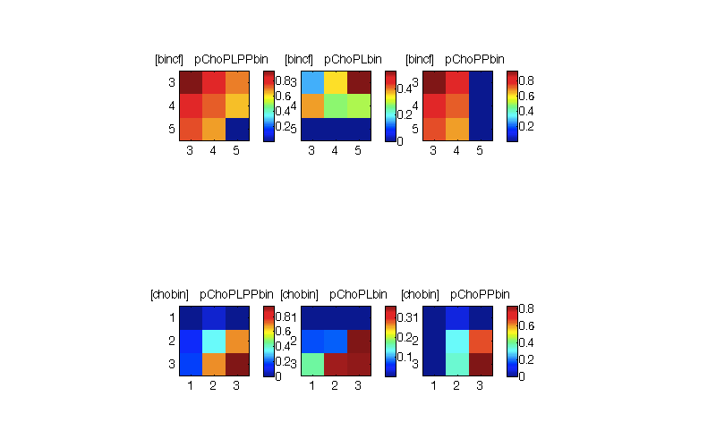
Randomly choose a dimension on each trial and pick the best option, w noise

Slide 8
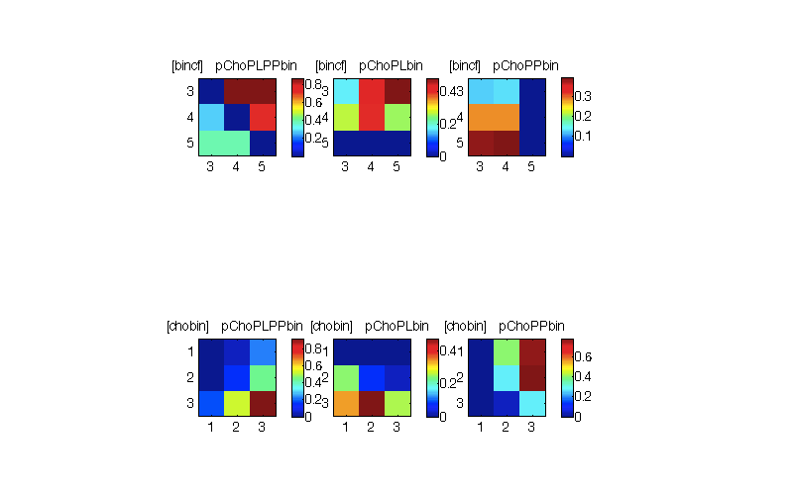
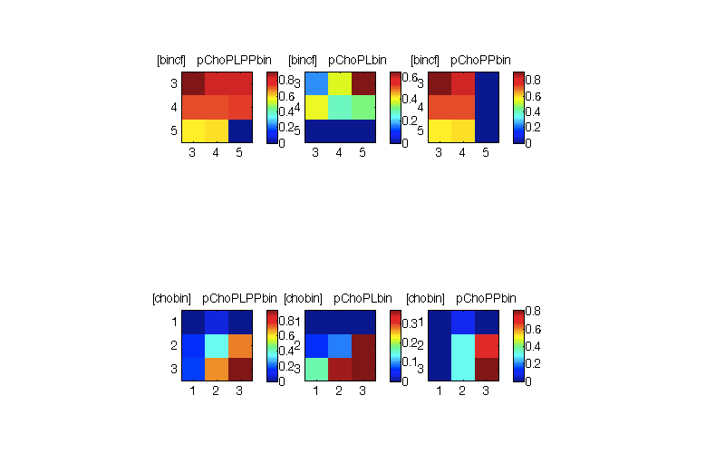
Picking (stochastically) on the basis of pleasure

Slide 9
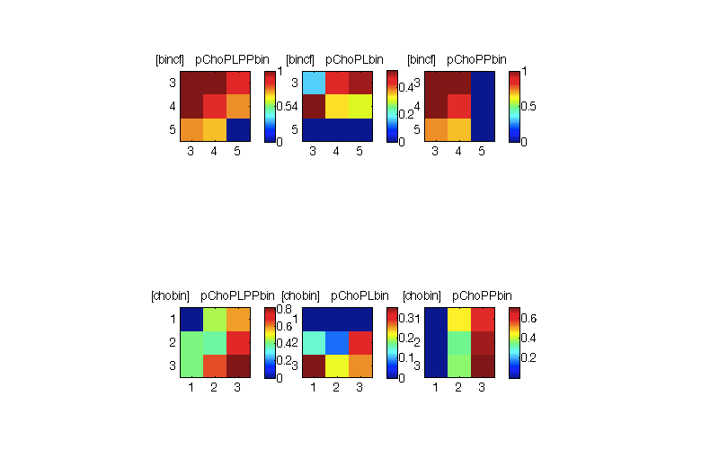
Hierarchical LCA
Does reproduce the qualitative pattern of behaviour

